Slide 1
Cluster

Slide 2
Age | 55.13±9.9
Gender | 338:937
R/L | 640:635
NTG:POAG | 709:566
MD(24-2) | -6.88±6.8
VFI(24-2) | 80.0±21 %

Slide 3
Number of factors = 8
Num of factor = 9

Slide 4
Cumulative Var 0.78

Slide 5
30-2 clustering(factor analysis)
 |  |  | 上鼻側 |  | 1 | 1 | 1 | 4 |  | 上耳側
 |  |  |  |  | 1 | 1 | 1 | 1 | 1 | 4
 |  |  |  | 1 | 1 | 1 | 1 | 1 | 1 | 4 | 4
 |  |  | 1 | 1 | 1 | 1 | 6 | 6 | 6 | 1 | 4 | 5
 |  |  | 1 | 1 | 1 | 6 | 6 | 6 | 6 | 6 | 5 | 5
 |  |  | 2 | 2 | 2 | 7 | 7 | 7 | 7 |  | 5 | 5
 |  |  | 2 | 2 | 2 | 2 | 7 | 7 | 7 | 3 | 5 | 5
 |  |  |  | 2 | 2 | 2 | 2 | 7 | 3 | 3 | 3
 |  |  |  |  | 2 | 2 | 3 | 3 | 3 | 3
 |  |  | 下鼻側 |  | 3 | 3 | 3 | 3 |  | 下耳側
 |  |  |  |  |  |  | 右眼

Slide 6
24-2 clustering(factor analysis)
NU |  |  |  |  |  |  |  |  | TU
 |  |  | 1 | 1 | 1 | 1
 |  | 1 | 1 | 1 | 1 | 1 | 5
 | 1 | 1 | 1 | 4 | 4 | 4 | 5 | 5
1 | 1 | 1 | 1 | 4 | 4 | 4 | × | 3 |  | 30°
2 | 2 | 2 | 2 | 7 | 6 | 6 | × | 3
 | 2 | 2 | 2 | 7 | 7 | 7 | 3 | 3
 |  | 2 | 2 | 2 | 2 | 3 | 3
 |  |  | 2 | 3 | 3 | 3
NL |  |  |  |  |  |  |  |  | TL
 |  |  |  | 右眼

Slide 7
combined

Slide 8
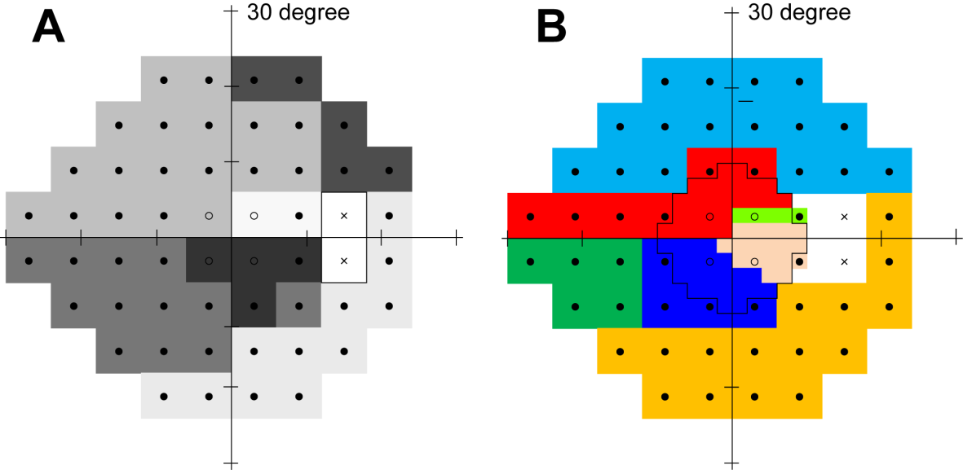

Slide 10
With factor correlations of
ML1 ML2 ML3 ML4 ML5 ML6 ML7 ML8
ML1 1.00 0.39 0.42 0.60 0.24 0.33 0.18 -0.19
ML2 0.39 1.00 0.62 0.30 0.13 0.46 0.44 0.10
ML3 0.42 0.62 1.00 0.33 0.32 0.53 0.35 0.06
ML4 0.60 0.30 0.33 1.00 0.13 0.44 0.36 -0.15
ML5 0.24 0.13 0.32 0.13 1.00 0.18 0.07 0.07
ML6 0.33 0.46 0.53 0.44 0.18 1.00 0.51 -0.10
ML7 0.18 0.44 0.35 0.36 0.07 0.51 1.00 0.03
ML8 -0.19 0.10 0.06 -0.15 0.07 -0.10 0.03 1.00

Slide 11
Factor Analysis; conventional TP
Factor = 7
Component = 5

Slide 12
Number of component
5
6
7

Slide 13
10-2 test point
 | 上鼻側 |  |  |  | 1 | 2 |  |  | 上耳側
 |  |  | 3 | 4 | 5 | 6 | 7 | 8
 |  | 9 | 10 | 11 | 12 | 13 | 14 | 15 | 16
 |  | 17 | 18 | 19 | 20 | 21 | 22 | 23 | 24
 | 25 | 26 | 27 | 28 | 29 | 30 | 31 | 32 | 33 | 34 | 10°
 | 35 | 36 | 37 | 38 | 39 | 40 | 41 | 42 | 43 | 44
 |  | 45 | 46 | 47 | 48 | 49 | 50 | 51 | 52
 |  | 53 | 54 | 55 | 56 | 57 | 58 | 59 | 60
 |  |  | 61 | 62 | 63 | 64 | 65 | 66
 | 下鼻側 |  |  |  | 67 | 68 |  |  | 下耳側
 |  |  |  |  | 右眼

Slide 14
10-2 test point
 | 上鼻側 |  |  |  | 2 | 2 |  |  | 上耳側
 |  |  | 2 | 2 | 2 | 2 | 2 | 2
 |  | 2 | 2 | 2 | 2 | 2 | 4 | 4 | 2
 |  | 2 | 2 | 2 | 2 | 4 | 4 | 4 | 4
 | 2 | 2 | 2 | 2 | 4 | 3 | 3 | 3 | 3 | 4 | 10°
 | 1 | 1 | 1 | 5 | 5 | 3 | 3 | 3 | 3 | 3
 |  | 1 | 1 | 5 | 5 | 3 | 3 | 3 | 3
 |  | 1 | 1 | 1 | 5 | 5 | 5 | 5 | 5
 |  |  | 1 | 1 | 1 | 1 | 5 | 5
 | 下鼻側 |  |  |  | 1 | 1 |  |  | 下耳側
 |  |  |  |  | 右眼

Slide 15
Conventional 10-2 test point
 | ST |  |  |  | 2 | 2 |  |  | SN
 |  |  | 2 | 2 | 2 | 2 | 2 | 2
 |  | 2 | 2 | 2 | 2 | 2 | 4 | 4 | 2
 |  | 2 | 2 | 2 | 2 | 4 | 4 | 4 | 4
 | 2 | 2 | 2 | 2 | 4 | 3 | 3 | 3 | 3 | 4 | 10°
 | 1 | 1 | 1 | 5 | 5 | 3 | 3 | 3 | 3 | 3
 |  | 1 | 1 | 5 | 5 | 3 | 3 | 3 | 3
 |  | 1 | 1 | 1 | 5 | 5 | 5 | 5 | 5
 |  |  | 1 | 1 | 1 | 1 | 5 | 5
 | IT |  |  |  | 1 | 1 |  |  | IN
 |  |  |  |  | 右眼

Slide 16
Inverted 10-2 test point
 | IT |  |  |  | 1 | 1 |  |  | IN
 |  |  | 1 | 1 | 1 | 1 | 5 | 5
 |  | 1 | 1 | 1 | 5 | 5 | 5 | 5 | 5
 |  | 1 | 1 | 5 | 5 | 3 | 3 | 3 | 3
 | 1 | 1 | 1 | 5 | 5 | 3 | 3 | 3 | 3 | 3 | 10°
 | 2 | 2 | 2 | 2 | 4 | 3 | 3 | 3 | 3 | 4
 |  | 2 | 2 | 2 | 2 | 4 | 4 | 4 | 4
 |  | 2 | 2 | 2 | 2 | 2 | 4 | 4 | 2
 |  |  | 2 | 2 | 2 | 2 | 2 | 2
 | ST |  |  |  | 2 | 2 |  |  | SN
 |  |  |  |  | 右眼

Slide 18
10-2 Nakanishi et al. vs Ours
 | ST |  |  |  | 2 | 2 |  |  | SN
 |  |  | 2 | 2 | 2 | 2 | 2 | 2
 |  | 2 | 2 | 2 | 2 | 2 | 4 | 4 | 2
 |  | 2 | 2 | 2 | 2 | 4 | 4 | 4 | 4
 | 2 | 2 | 2 | 2 | 4 | 3 | 3 | 3 | 3 | 4 | 10°
 | 1 | 1 | 1 | 5 | 5 | 3 | 3 | 3 | 3 | 3
 |  | 1 | 1 | 5 | 5 | 3 | 3 | 3 | 3
 |  | 1 | 1 | 1 | 5 | 5 | 5 | 5 | 5
 |  |  | 1 | 1 | 1 | 1 | 5 | 5
 | IT |  |  |  | 1 | 1 |  |  | IN
 |  |  |  |  | 右眼
Nakanishi H. IOVS. 2016

